Slide 1
CRICKET BALL SPIN MODELING
-Sachin Saxena

Slide 2
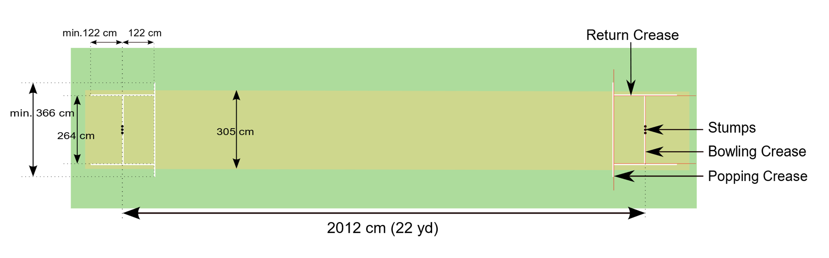
INTRODUCTION
Cricket is a bat-and-ball game played between two teams of eleven players on a field at the centre of which is a 20-metre (22-yard) pitch with a wicket at each end, each comprising two bails balanced on three stumps
The ball is a hard leather-seamed spheroid, with a diameter of 72mm
The pitch surface is flat is flat and normally covered with extremely short grass

Slide 3

Cricket Ball Spin

Slide 4
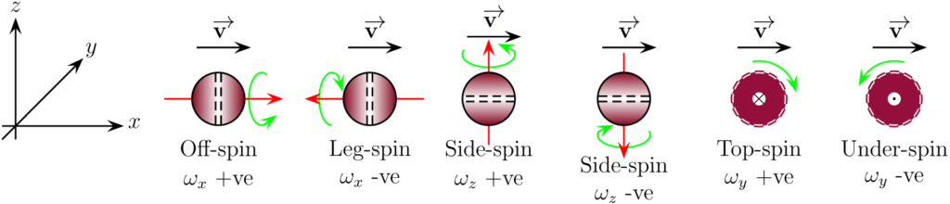
Types of Spin

Slide 5
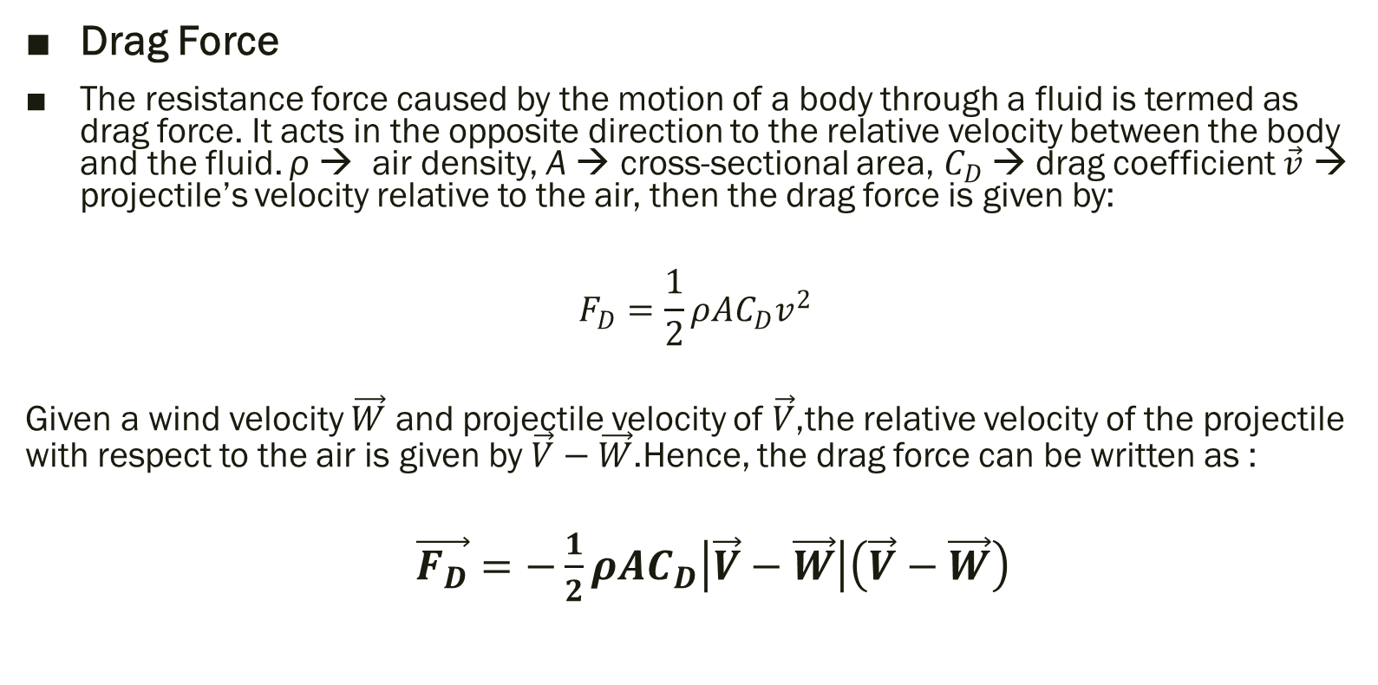
Forces Involved
Drag Force
The resistance force caused by the motion of a body through a fluid is termed as drag force. It acts in the opposite direction to the relative velocity between the body and the fluid. ρ → air density, A → cross-sectional area, $C_{D}$→ drag coefficient $\vec{v}$ → projectile’s velocity relative to the air, then the drag force is given by:
$$F_{D}=\frac{1}{2}ρAC_{D}v^{2}$$
Given a wind velocity $\vec{W}$ and projectile velocity of $\vec{V}$,the relative velocity of the projectile with respect to the air is given by $\vec{V}−\vec{W}$.Hence, the drag force can be written as :
$\vec{F_{D}}=−\frac{1}{2}ρAC_{D}\left|\vec{V}−\vec{W}\right|\left(\vec{V}−\vec{W}\right)$

Slide 6
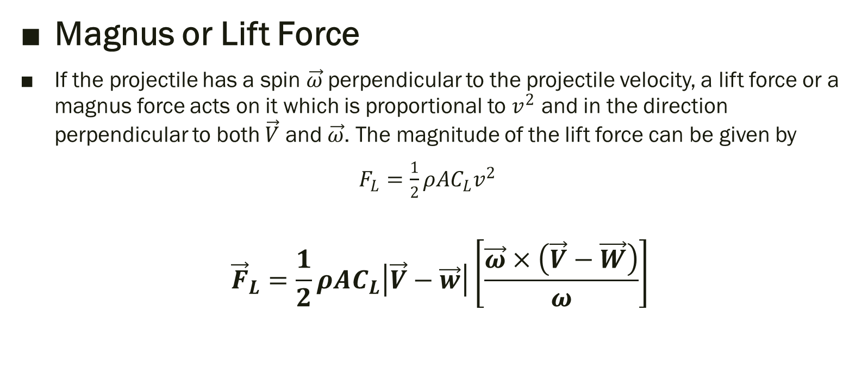
Forces Involved
Magnus or Lift Force
If the projectile has a spin $\vec{ω}$perpendicular to the projectile velocity, a lift force or a magnus force acts on it which is proportional to $v^{2}$ and in the direction perpendicular to both $\vec{V}$ and $\vec{ω}$. The magnitude of the lift force can be given by
$F_{L}=\frac{1}{2}ρAC_{L}v^{2}$
$${\vec{F}}_{L}=\frac{1}{2}ρAC_{L}\left|\vec{V}−\vec{w}\right|\left[\frac{\vec{ω}×\left(\vec{V}−\vec{W}\right)}{ω}\right]$$

Slide 7

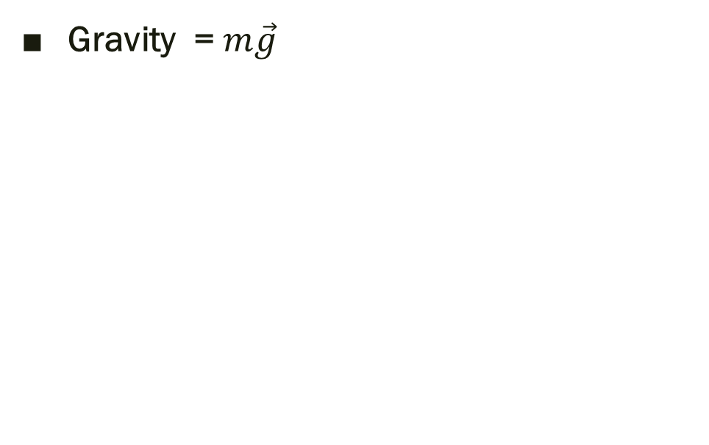
Forces Involved
Gravity = $m\vec{g}$

Slide 8
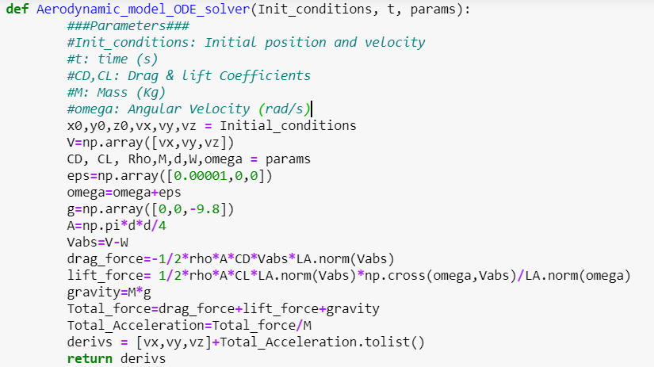
Code
To avoid ‘Division by zero’ error later

Slide 9
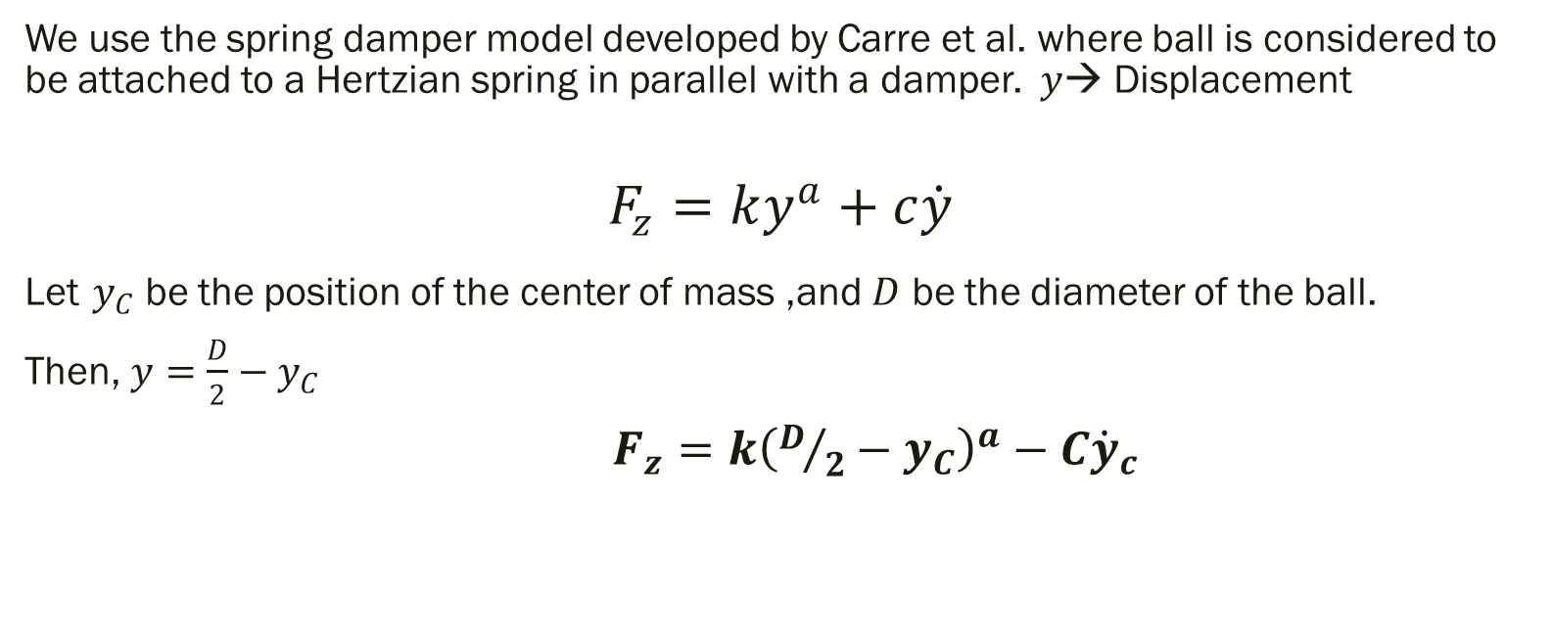
Spring Damper Bounce Model
We use the spring damper model developed by Carre et al. where ball is considered to be attached to a Hertzian spring in parallel with a damper. $y$→ Displacement
$$F_{z}=ky^{a}+c\dot{y}$$
Let $y_{C}$ be the position of the center of mass ,and $D$ be the diameter of the ball.
Then, $y=\frac{D}{2}−y_{C}$
$F_{z}=k{\left(D/2−y_{C}\right)}^{a}−C{\dot{y}}_{c}$

Slide 10
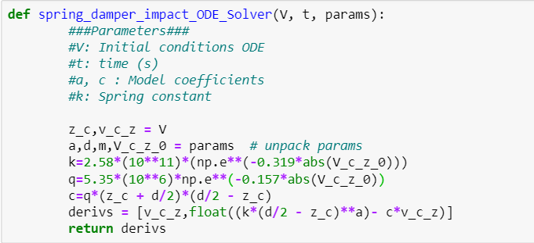
Code

Slide 11
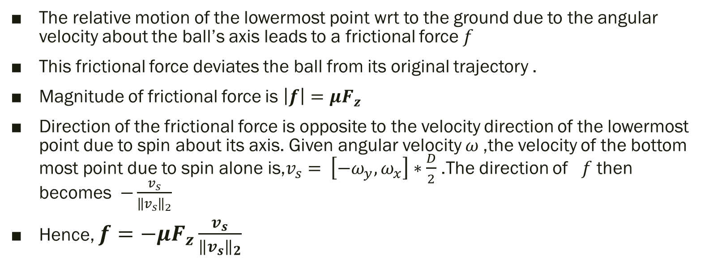
Frictional Force
The relative motion of the lowermost point wrt to the ground due to the angular velocity about the ball’s axis leads to a frictional force $f$
This frictional force deviates the ball from its original trajectory .
Magnitude of frictional force is $\left|f\right|=μF_{z}$
Direction of the frictional force is opposite to the velocity direction of the lowermost point due to spin about its axis. Given angular velocity $ω$,the velocity of the bottom most point due to spin alone is,$v_{s}=$ $\left[−ω_{y},ω_{x}\right]∗\frac{D}{2}$ .The direction of $f$ then becomes $−\frac{v_{s}}{{\left\|v_{s}\right\|}_{2}}$
Hence, $f=−μF_{z}\frac{v_{s}}{{\left\|v_{s}\right\|}_{2}}$

Slide 12
Code
#Calculate frictional force
F_friction=mu* F_z
omega_net=np.array([-Omega_0[0][1]*d/2 ,Omega_0[0][0]*d/2,0])
omega_net=np.reshape(omega_net,(1,3))
Friction_dir=-np.reshape((omega_net/LA.norm(omega_net)),(1,3))
F_friction_vector= (F_friction).dot(Friction_dir)

Slide 13
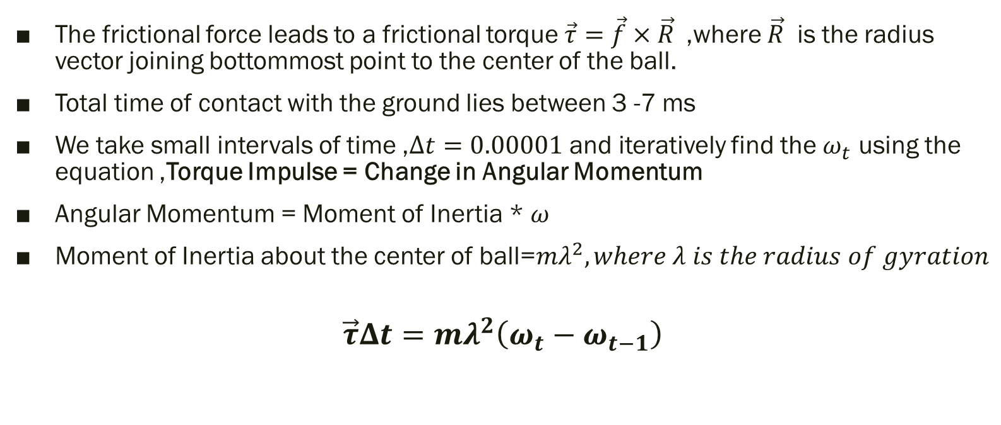
Spin Change due to Friction
The frictional force leads to a frictional torque $\vec{τ}=\vec{f}×\vec{R}$,where $\vec{R}$ is the radius vector joining bottommost point to the center of the ball.
Total time of contact with the ground lies between 3 -7 ms
We take small intervals of time ,$Δt=0.00001$ and iteratively find the $ω_{t}$ using the equation ,Torque Impulse = Change in Angular Momentum
Angular Momentum = Moment of Inertia * $ω$
Moment of Inertia about the center of ball=$mλ^{2}, where λ is the radius of gyration$
$$\vec{τ}Δt=mλ^{2}\left(ω_{t}−ω_{t−1}\right)$$

Slide 14
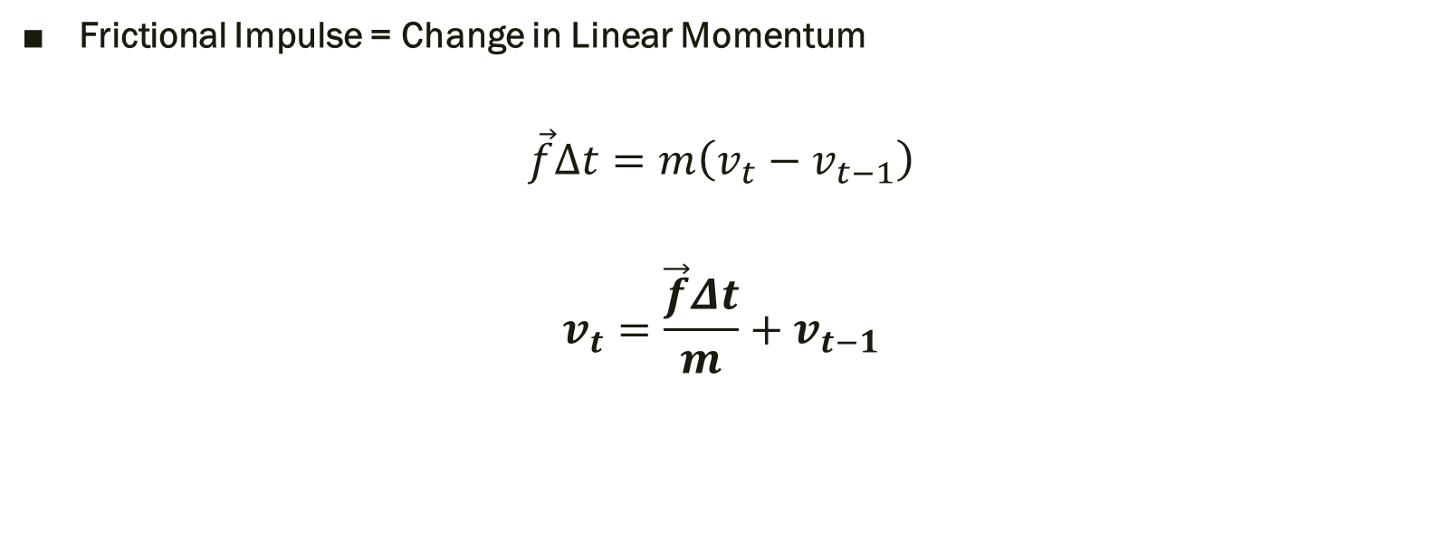
Change in Linear Velocity due to Friction
Frictional Impulse = Change in Linear Momentum
$$\vec{f}Δt=m\left(v_{t}−v_{t−1}\right)$$
$$v_{t}=\frac{\vec{f}Δt}{m}+v_{t−1}$$

Slide 15
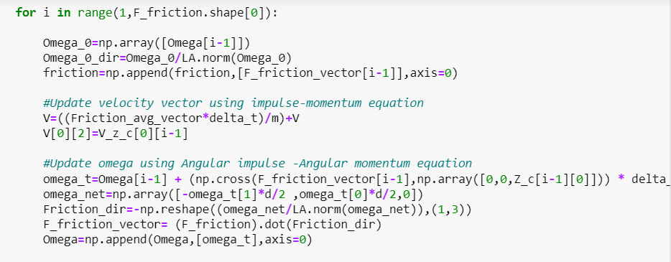
Code

Slide 16
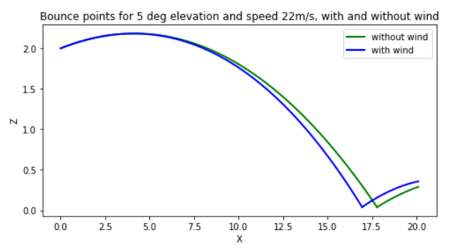
Bounce points for 5 deg launch elevation, and speed of 22m/s with and without wind

Slide 17
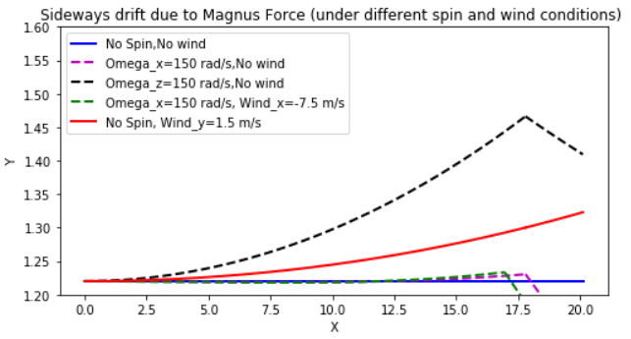
Sideways drift due to magnus or lift force & comparison of drifts in different spinning conditions

Slide 18
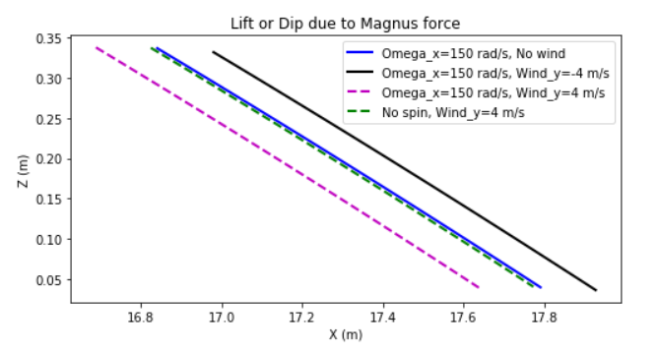
Lift or Dip due to Magnus Force

Slide 19
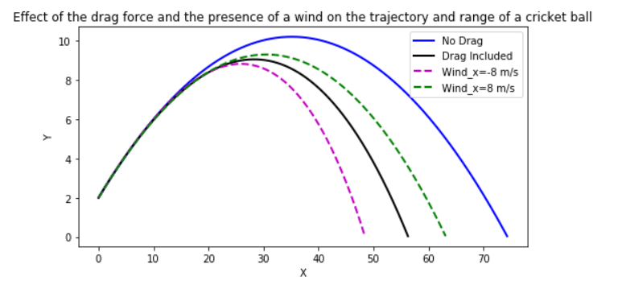
The effect of the drag force and the presence of a wind on the trajectory and range of a cricket ball.
(Initial speed of 30 m s−1 (108 km h−1) and at an elevation angle of 25◦)

Slide 20
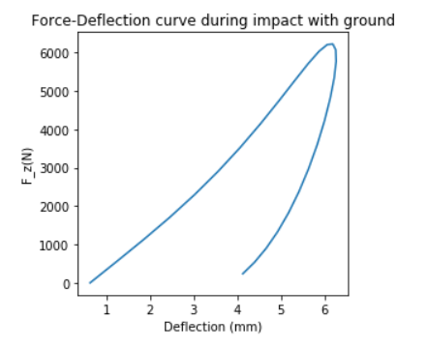
Force Deflection curve during impact with ground

Slide 21
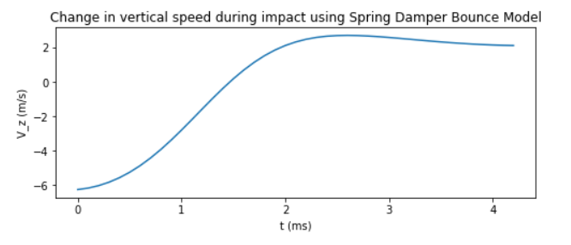
Spring Damper Bounce Profiles

Slide 22
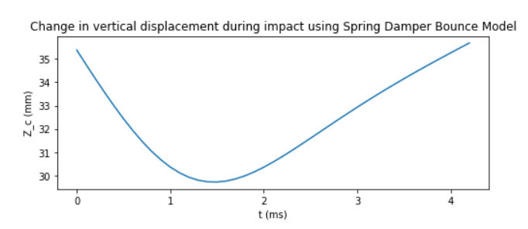
Spring Damper Bounce Profiles

Slide 23
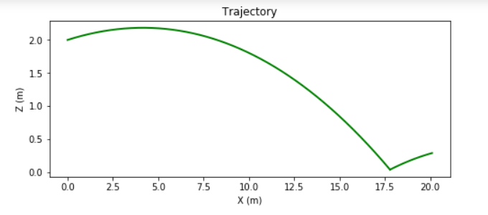
Overall Trajectory

Slide 24
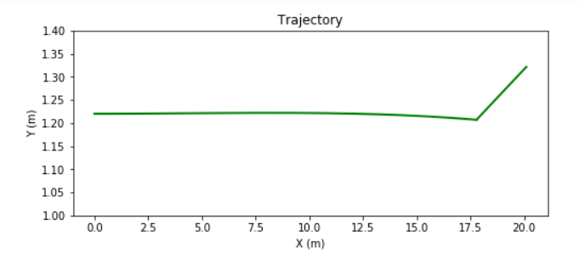
Overall Trajectory

Slide 25
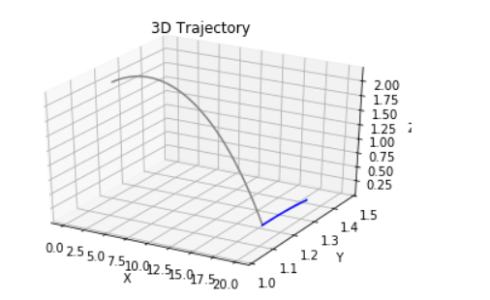
3D Trajectory

Slide 26
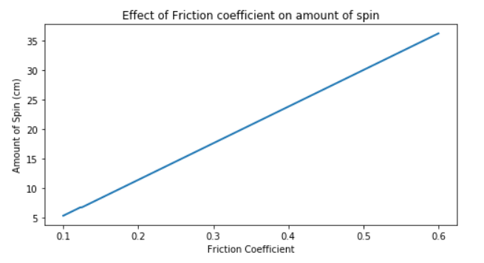
Effect of Friction on Amount of Spin

Slide 27
Thank you!
Questions?

